Slide 1
GIT REPOSITORY

Slide 2
INTRODUCTION
Git Repository is Distributed Version Control System.
Actually There Two Types Of Version control systems
1.Central VCS and
2. Distributed VCS

Slide 3
VERSION CONTROL SYSTEM
Version control is a system that records changes to a file or set of files over time so that you can recall specific versions later.
For the examples , you will use software source code as the files being version controlled, though in reality you can do this with nearly any type of file on a computer.

Slide 4
Purpose
Version control systems are a category of software tools that helps record changes to files by keeping a track of modifications done to the code.
Use of Version Control System: A repository: It can be thought as a database of changes. It contains all the edits and historical version(Snap shot) of the Project.

Slide 5
TYPES OF VCS
CENTRAL VCS : central vcs is where Your Data Is placed Remotly and You have To acces the Data Centrally.
There is a problem with Central Vcs that As It is has no backup , if it goes down or hacked your toatal information will be lossed.

Slide 6
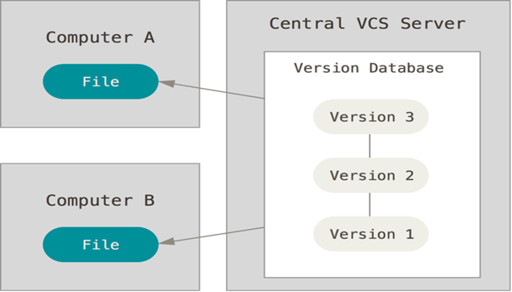
CENTAL VERSION CONTROL SYSTEM

Slide 7
DISTRIBUTED VCS
In This Vcs, Every user will have their own Repository in ther local host,which also present in remote repository.
Your Local Repository Will Have The Every Information of Your Remote Repository based on the last Time You Synced It.
It Is Like Every Developer Has A Entire Backup Of Their Repository.

Slide 8
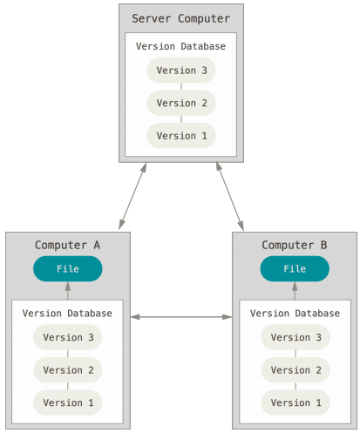
DISTRIBUTED VCS

Slide 9
COMMANDS
git - - version
This command is used to check the version installed in your host.
git config - - global user.name “xyz123”
git config - -global user.email “xyz123@gmail.com”.
This configuration is used to accessing your repository and what changes made.

Slide 10
Common Scenario's
1. Using Git for existing project in locally.
2. Using Git for project from Remote area.

Slide 11
1.Using Git for existing project locally:
If you have local code based project and wanted to track using Git. This can be done by running the command in your directory of the project using terminal.
Git init
When you Run this command a new .git file is created in your folder and you can keep tracking this folder.
Before we commit the file into repository,once check is their any untracked files by using command.
Git status
If your file consist of personal or important information and you don’t want others to view your file so you use command
Touch .gitignore
This command will create a folder which will other users to view the files inside it.

Slide 12
Different Stages
We have 3 different stages
1. Working Directory: This is where our files and unchecked files are stored.
2.Staging Area :Staging area is where we have our file before commit and that we can check what to commit and what files not to commit.
3.repository: This is where our files are stored after the commit.

Slide 13
Staging Area
This is where our files are updated or changed.
git add-A
This command is used to add the file to staging area, where –A will add all filesat once to staging area.
You can also add them individually by using
git add <.filename>

Slide 14
Commit
To Commit the code into repository we use command
git commit –m “massage you want to display”
To know which files are commited to the repository and who commited that file,
git log

Slide 15
USING GIT FOR REMOTE RIEPOSITORY
To clone files from the remote repository use the commands
git clone<url> <where to clone>
Example: git clone ../git .
Here (.) means the current directory or folder and git is the folder in host.
To view information about remote repository where your repository is
git remote –v
To list all branches in your repository
git branch -a

Slide 16
When we update/change any file and this also needed to be updated in remote/local repository,use command
git diff
This command will display recent changes made.
After changing againg add the files to staging.
git add –A
After adding to stage then commit the changed file
git commit –m “modified file”
git pull origin master
git push origin master
These command pull and push will pull and push the code into master branch .

Slide 17
Thank You

